Slide 1
Celebrity Profiling
Aniket Tikotkar
Priyanka Mannikeri
Sahil Shah
ISTE 612: Knowledge Processing Technologies
Prof. Jai Kang

Slide 2
Agenda
Motivation
Problem Definition
Key Issues
Alternate Methods and Solutions
Related Work and Limitations
Our Approach
Validation
Conclusion
Future Work

Slide 3
Motivation
Celebrities have a massive following and influence a lot of people
By predicting their traits, we see how the tweets are capable of moving people
This information can be used by companies to promote their products

Slide 4
Problem Definition
Prediction of user profile information like the age, gender and profession based on celebrities tweet .

Slide 5
Key Issues
Handling enormous raw tweet data from the tweets of celebrities.
Transforming raw tweet data into features.
Selecting a machine learning algorithm.

Slide 6
Alternate Methods and Solution
The Featuriser we have used is ngram tfidf ,but instead we can also use more sophisticated featuriser like “word2vec”.
https://en.wikipedia.org/wiki/Word2vec
We used Decision tree as Machine Learning Algorithm. Many others have used Logistic regression, SVM, Neural networks etc.

Slide 7
Related Work and Limitations
Baseline work of PAN 2019 dataset .
https://github.com/pan-webis-de/pan-code/blob/master/clef20/celebrity-profiling/pan20-celebrity-profiling-ngram-baseline.py
They used logistic regression which doesn’t generalise well on the test dataset.

Slide 8
Our Approach
For featuring tweet data we used tfidf ngrams.
To learn the features we used Decision tree classifier as the core machine learning algorithm.
We developed static HTML webpage that displays 10 predicted examples along with their ground truth labels.
We developed an interactive GUI based system that reads an entered tweet (from test data) and displays the celebrity trait predicted from the model.

Slide 9
Validation
Accuracy for age model: 27.02%
Accuracy for gender model: 70.35%
Accuracy for occupation model: 46.80%

Slide 10
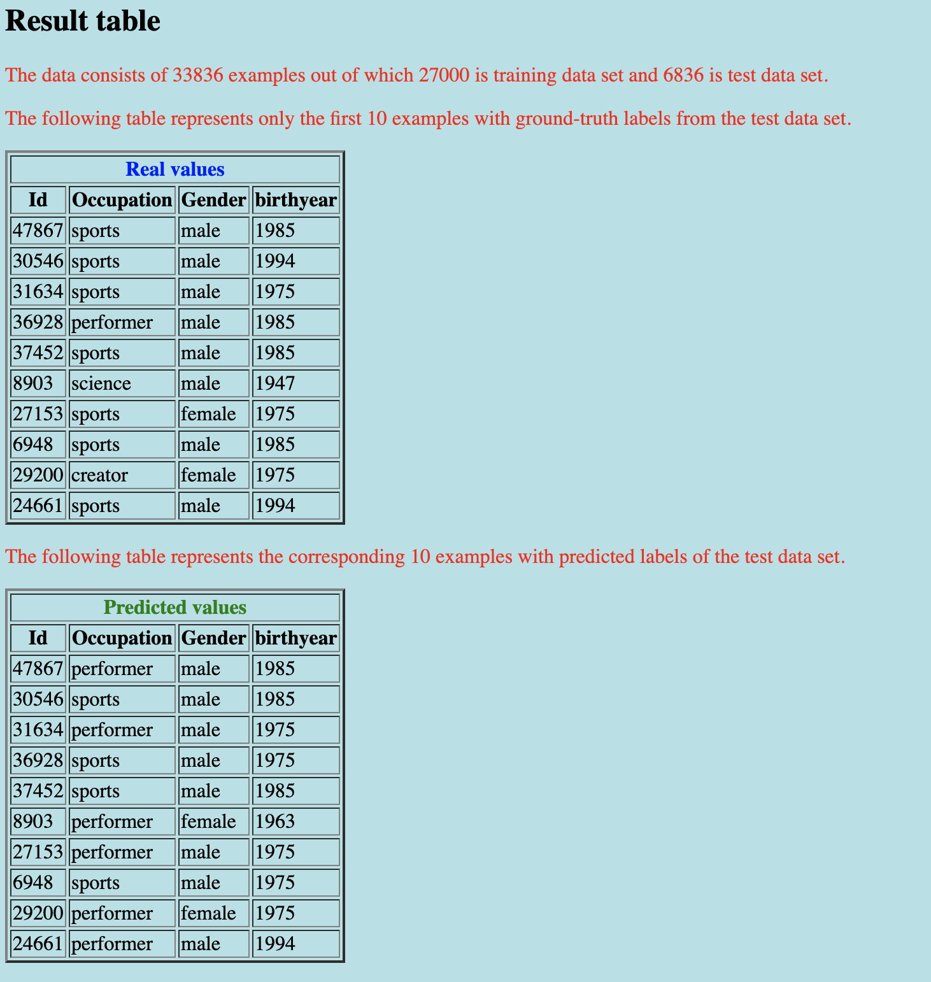
Validation
Static HTML webpage

Slide 11
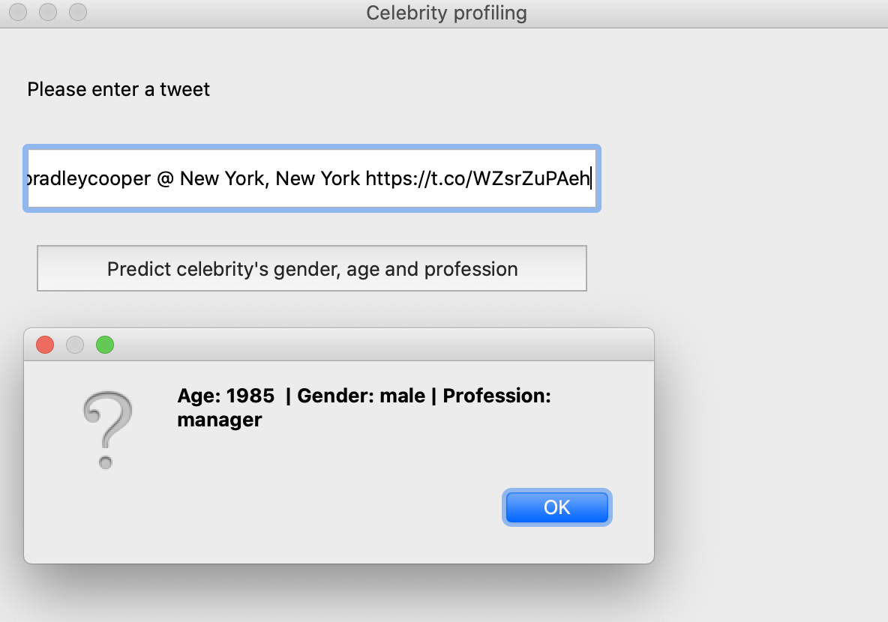
Validation
PyQt Interactive GUI

Slide 12
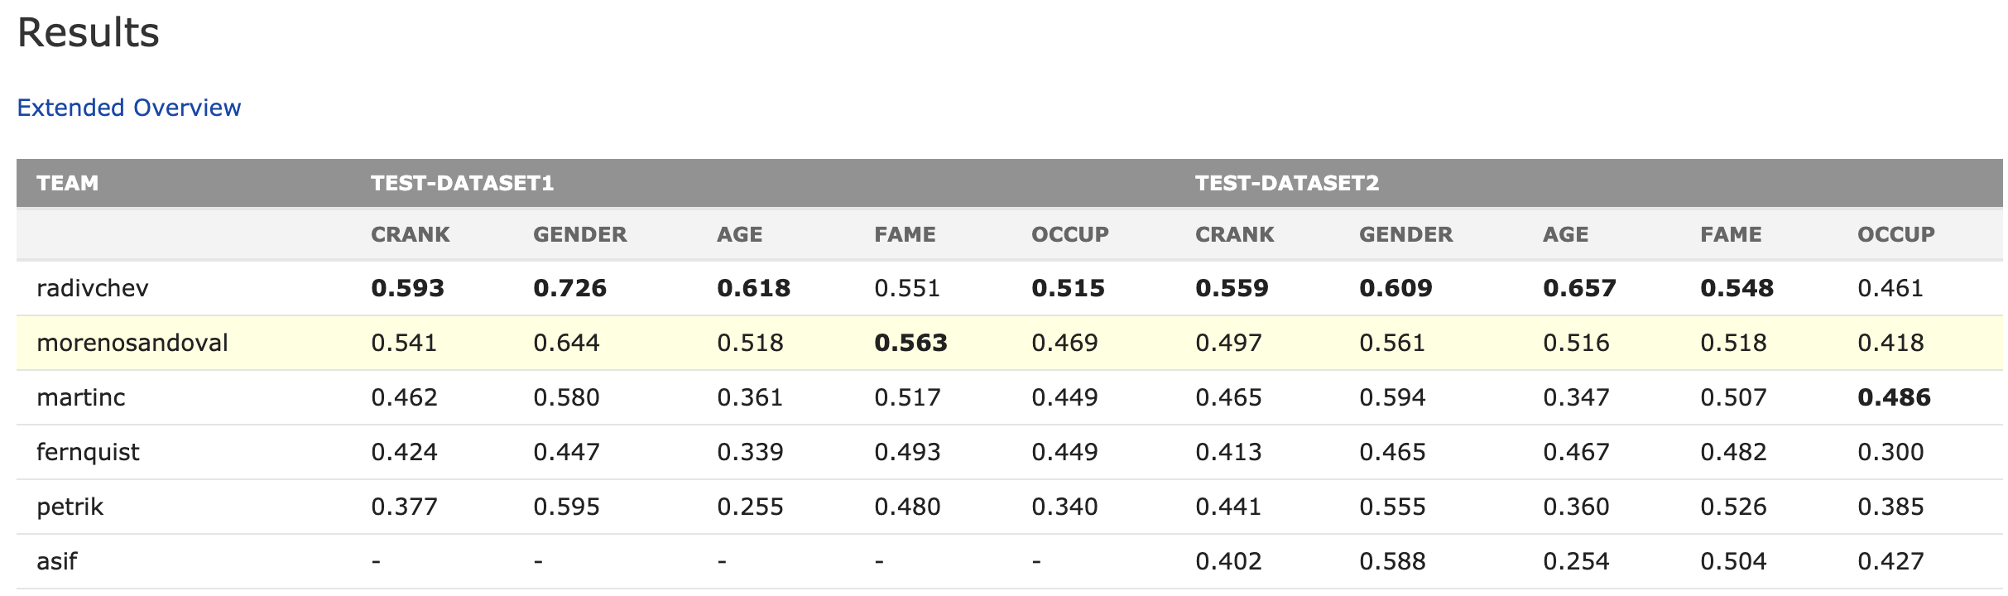
Results:
Below is the results of various participants in PAN 2019 celebrity profiling competition.We stand at rank 2 for Gender classification(0.70),rank 3 for occupation classification(0.46) and rank 5 for age classification (0.27)
https://pan.webis.de/clef19/pan19-web/celebrity-profiling.html#results

Slide 13
Conclusion
We attempted to solve the task of Celebrity profiling using twitter data and the algorithms used are ngram, tfidf and Decision tree.
We performed the evaluation and achieved competitive results.
We built static HTML and interactive GUI for visualising the results.

Slide 14
Future Work
Use more sophisticated featuriser to achieve even better results.
Deploy of fully working webpage on the server.
Investigate more ML algorithms like neural networks and deep learning based approaches.

Slide 15
Thank You

